Slide 1

Primitive Diagnosis Of Respiratory Diseases
TEAM:
BREN JOEL SIKHA
BENAZEER SHAIK
SASANK NAKKA
GNANESH PAMOTI

Slide 2
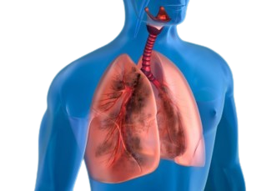
Abstract
Rising mortality from lung diseases in India prompts the need for early diagnosis.
Current diagnostic methods, notably in rural areas, have limitations.
Project aims to develop a deep learning model for accurate lung disease diagnosis.
Deep learning models improve efficiency and accuracy in detecting abnormalities. Benefits include addressing healthcare disparities in rural areas and enabling early detection for better outcomes.

Slide 3
Introduction
The project addresses timely and accurate detection of lung diseases using Machine Learning (ML).
Leveraging a dataset of chest X-ray images, advanced ML algorithms, specifically Convolutional Neural Networks (CNNs), analyze patterns for predictive modeling.
Aims to revolutionize healthcare technology, making lung disease prediction more accessible and efficient.
Seeks to contribute to early intervention and improved management of respiratory conditions by combining ML and IoT technologies.

Slide 4
Existing Methodology
Limited Scope: Current methodologies only classify a single disease per X-ray, restricting diagnostic potential.
Risk of Misdiagnosis: Lack of multi-class classification increases the likelihood of erroneous results and delays appropriate treatment.
Narrow Focus: Existing models predominantly target TB or pneumonia, overlooking the need for comprehensive multi-disease diagnosis.
Healthcare Impact: Suboptimal methodologies hinder patient care by impeding timely and accurate diagnosis, highlighting the necessity for advancements in X-ray classification.

Slide 5
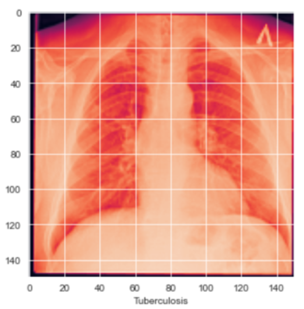
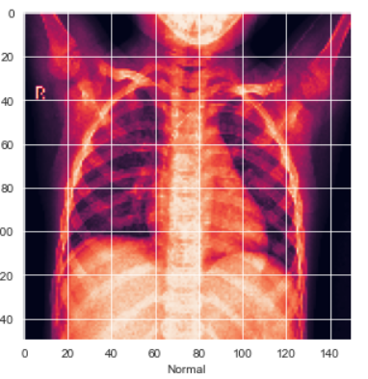
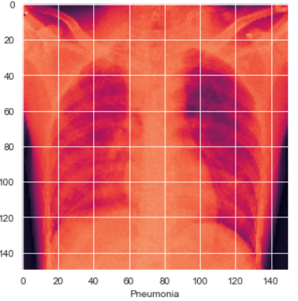
Proposed Model
Rising mortality from lung diseases in India prompts the need for early diagnosis.
Current diagnostic methods, notably in rural areas, have limitations.
Project aims to develop a deep learning model for accurate lung disease diagnosis.
Deep learning models improve efficiency and accuracy in detecting abnormalities. Benefits include addressing healthcare disparities in rural areas and enabling early detection for better outcomes.

Slide 6
Workflow
Training & Testing
X-Ray Images
Pre-processing
Features
Training using CNN
Normal or TB or Pneumonia
Evaluation Results
Prediction Model
Classifer

Slide 7

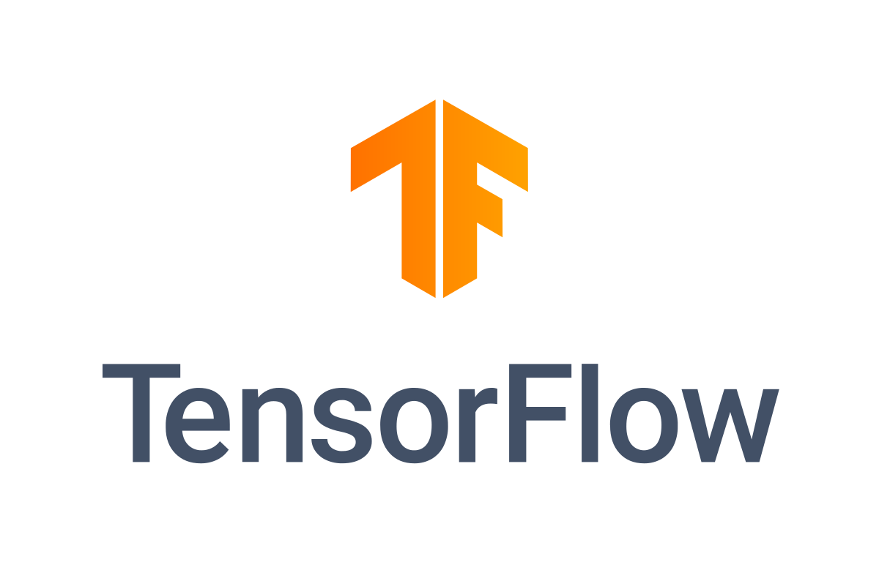


Tech Stack
Programming Language:
Python
Deep Learning Frameworks:
TensorFlow
Keras
OpenCV (cv2)
Development Environment:
Jupyter Notebook
Data Manipulation and Analysis:
NumPy, Pandas
Matplotlib, Seaborn

Slide 8
Future Scope
Expansion of Disease Classification: Incorporate additional diseases beyond TB, pneumonia, and normal health, enhancing the model's diagnostic capabilities.
Web Accessibility: Develop a user-friendly web interface by enabling direct submission of X-ray images to facilitate easy access to the diagnostic model for healthcare professionals and patients.
Integration of IoT Devices: Incorporate IoT devices for seamless data collection and real-time monitoring, enhancing the model's adaptability and responsiveness.
Advancements in Efficiency: Continuously refine the model's algorithms and workflows to optimize diagnostic accuracy and efficiency, ensuring timely and reliable results.

Slide 9
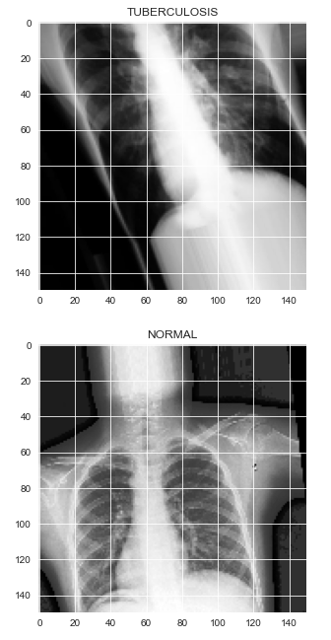

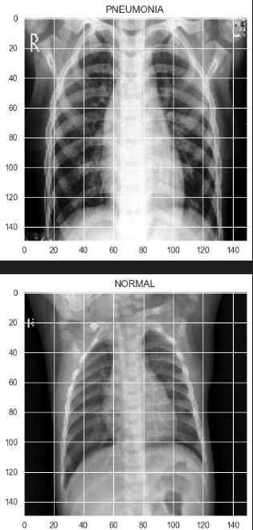
Results
INPUT X-RAYS
Diagnosed Respiratory Diseases

Slide 10
Conclusion
Successful use of deep learning, particularly CNNs, for accurate respiratory disease classification from chest X-rays.
Effective CNN architecture implementation using Keras, enabling precise disease classification from X-ray patterns.
Continuous improvement in model accuracy and loss through training and validation epochs.
Potential for further enhancements through integration with patient metadata and clinical history.
Importance of rigorous validation and collaboration for real-world deployment, paving the way for future research in early disease detection and treatment using advanced ML techniques.

Slide 11



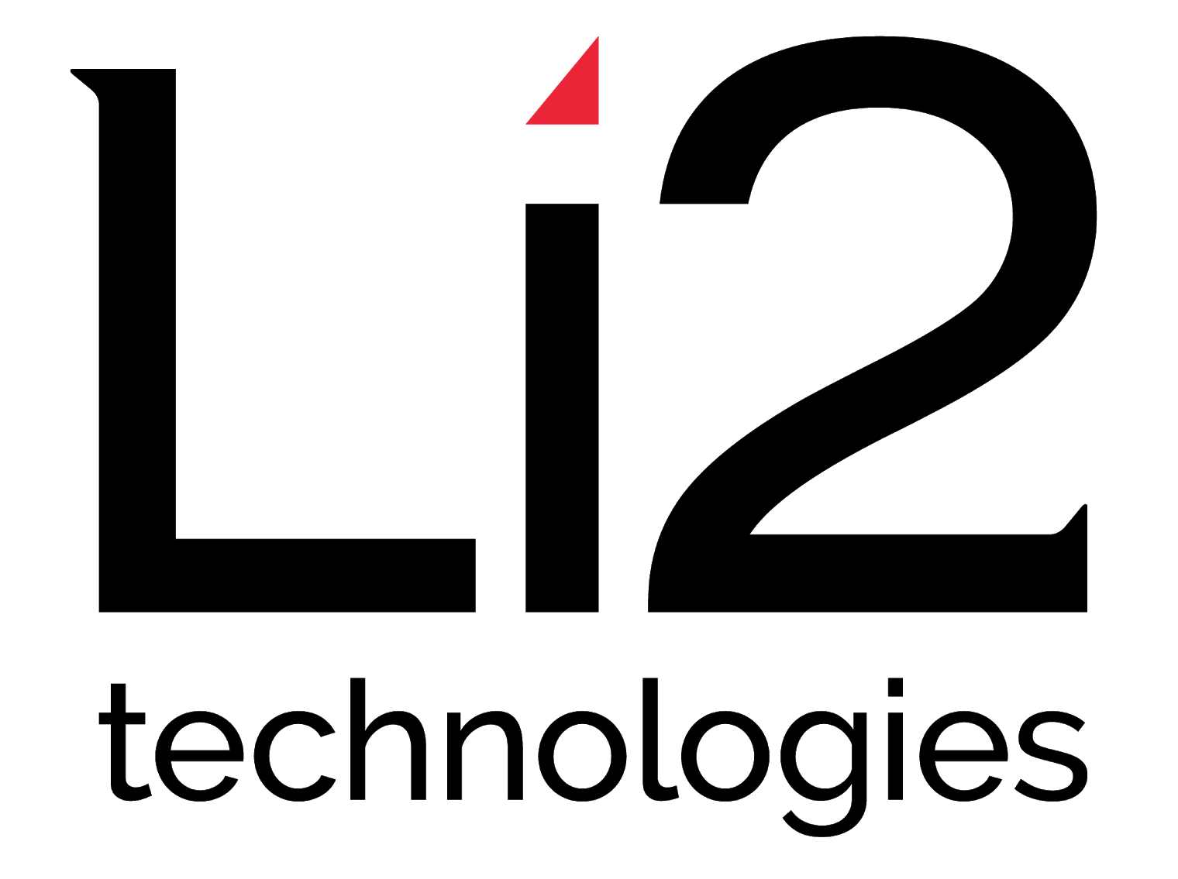
www.hexart.in
Sponsored by
THANK YOU
CSR Partner
Implementation Partner

